Slide 1

Advanced course
Lesson 23
DIY coures（1）
A birthday gift
YahBoom Croco:Kit tutorial

Slide 2
Advanced course
Content
Part1
Part 2
Part3
Part 4
Part 5
Learning goals
Preparation
Connection
Search for blocks
Combine blocks
YahBoom Croco:Kit tutorial

Slide 3
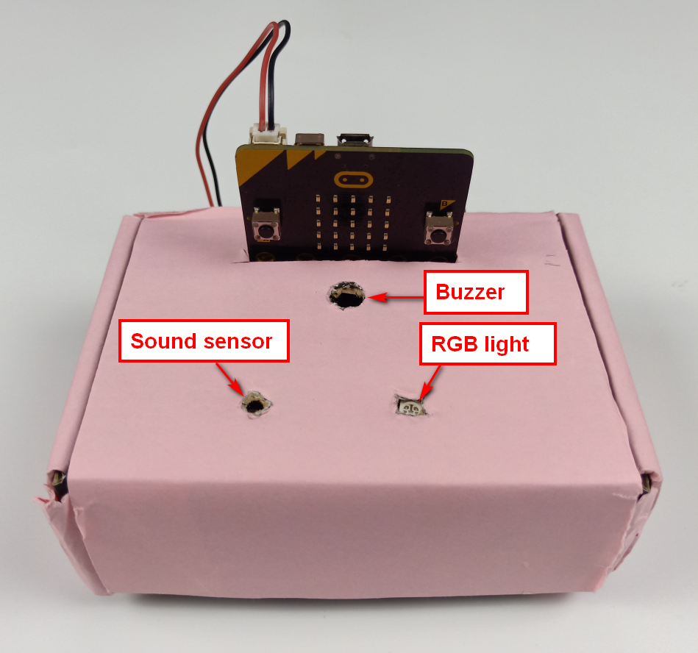
Advanced course
Part 1
Learning goals
After downloading the program, we can see the word 'Happy Birthday!' on the Micro:bit LED dot matrix. When we blow the air module or clap the sound module, the buzzer plays a happy birthday when the sound sensor detects the sound. The brightness of the RGB light and the height of the dot pattern on the dot matrix change with the sound intensity.
YahBoom Croco:Kit tutorial

Slide 4
Advanced course
Part 2
Hardware:
● 1 X Micro:bit Board
● 1 X Micro USB Cable
● 1 X Diamond breakout
● 1 X RGB light module
● 1 X Sound module
● 5 X Alligator clip
● 1 X PC
Preparation
Mode 1 online programming: First, we need to connect the micro:bit to the computer by USB cable. The computer will pop up a USB flash drive and click on the URL in the USB flash drive: http://microbit.org/ to enter the programming interface. Add the Yahboom package: https://github.com/lzty634158/Croco-Kit to program.
Mode 2 offline programming: We need to open the offline programming software. After the installation is complete, enter the programming interface, click【New Project】, add Yahboom package: https://github.com/lzty634158/Croco-Kit , you can program.
YahBoom Croco:Kit tutorial

Slide 5
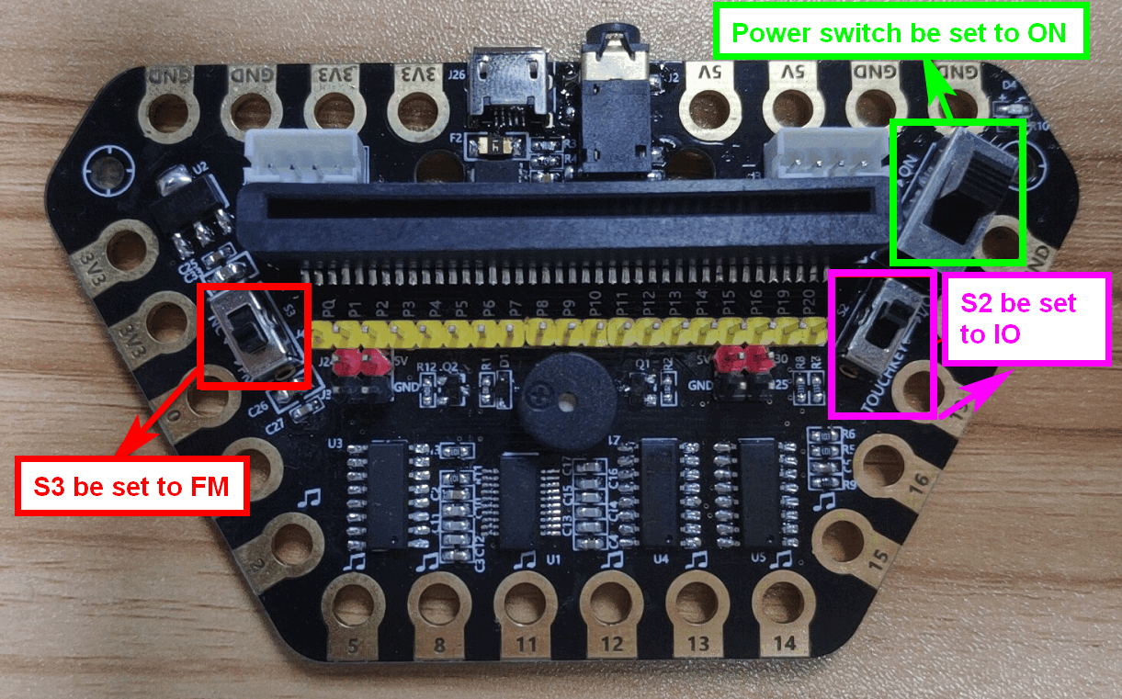
Advanced course
Part 2
Preparation
! ! !Note: S1 be set to the ON, S2 be set to the IO, and S3 to the FM.
YahBoom Croco:Kit tutorial

Slide 6
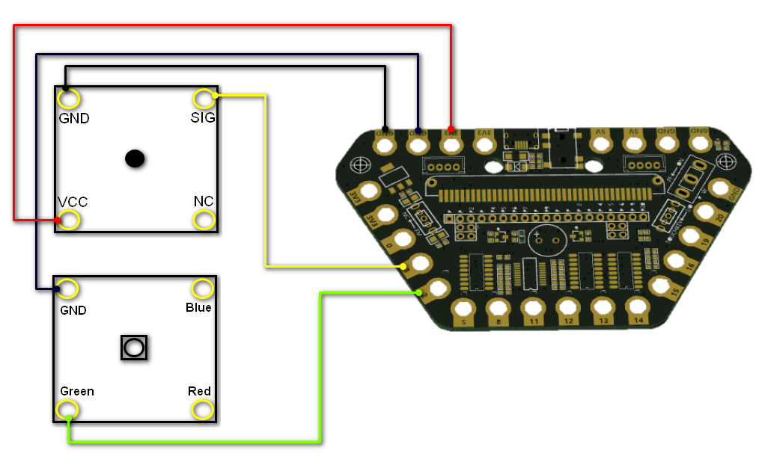
Advanced course
Part 3
Expansion board | RGB light Module | Sound Module
P1 |  | SIG
P2 | Green
3.3V |  | VCC
GND | GND | GND
Connection
YahBoom Croco:Kit tutorial

Slide 7
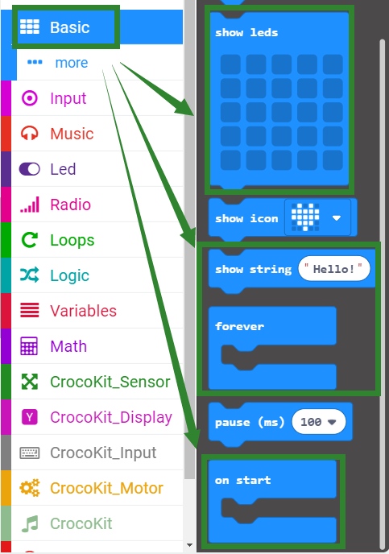
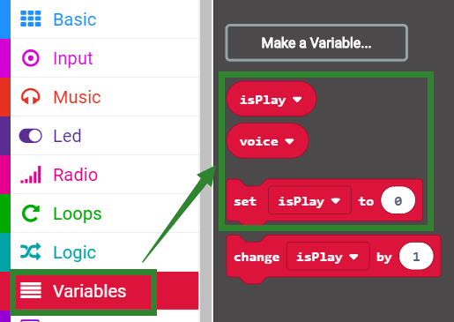
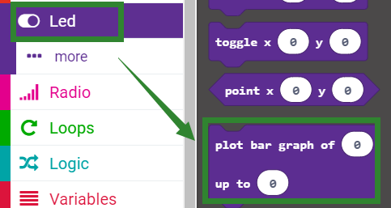
Advanced course
Part 4
Search for blocks
YahBoom Croco:Kit tutorial

Slide 8
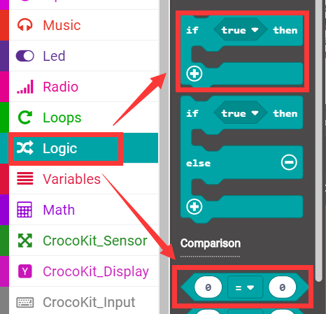
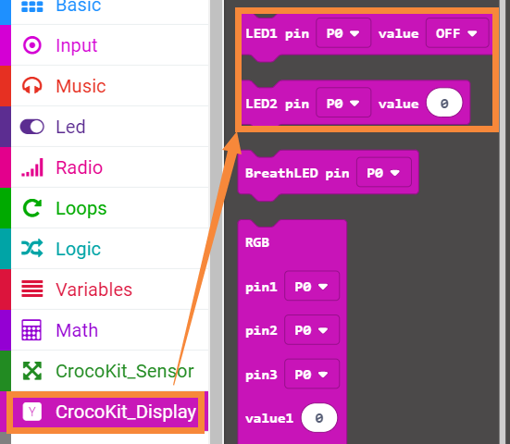
Advanced course
Part 4
Search for blocks
YahBoom Croco:Kit tutorial

Slide 9
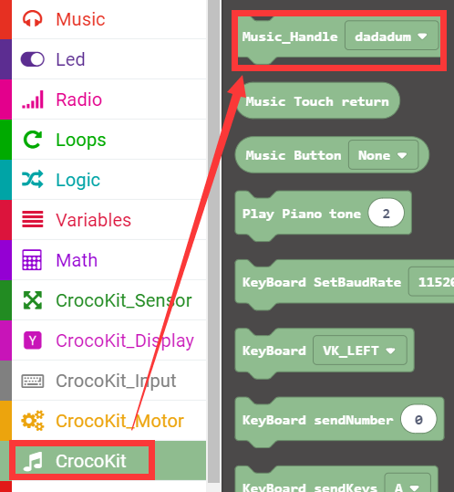
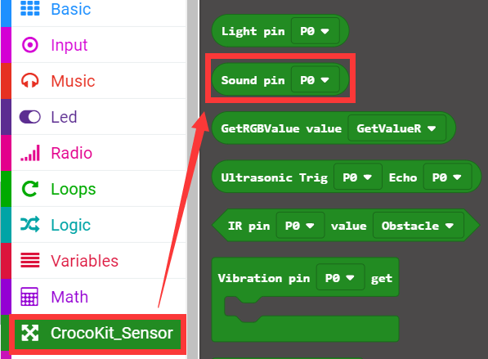
Advanced course
Part 4
Search for blocks
YahBoom Croco:Kit tutorial

Slide 10
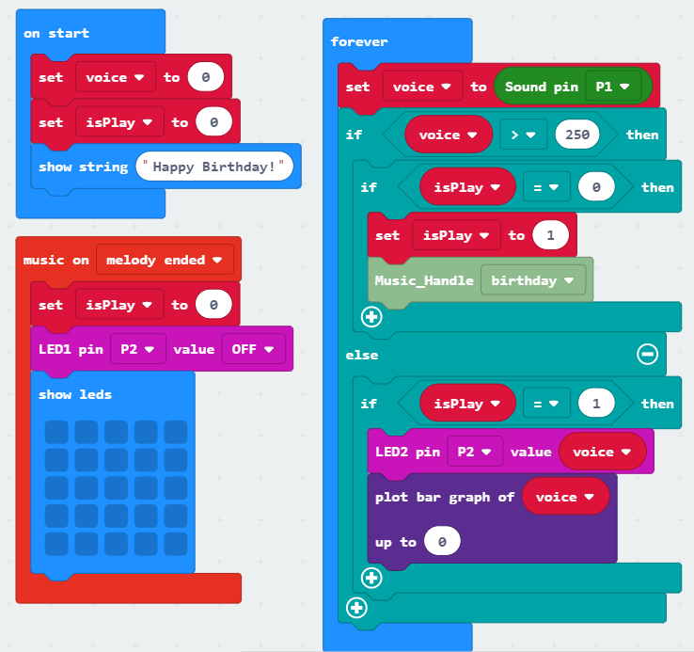
Advanced course
Part 5
Combine blocks
YahBoom Croco:Kit tutorial

Slide 11
Advanced course
Thank you ！
Powered by YahBoom
YahBoom Croco:Kit tutorial

